Slide 1
Digital economy
Patrick Waelbroeck

Slide 2
Lecture 1
Introduction

Slide 3
Does the digital economy matter?
Title: Presentation
Subtitle field
Everyday life
Socially important
Economically important

Slide 4
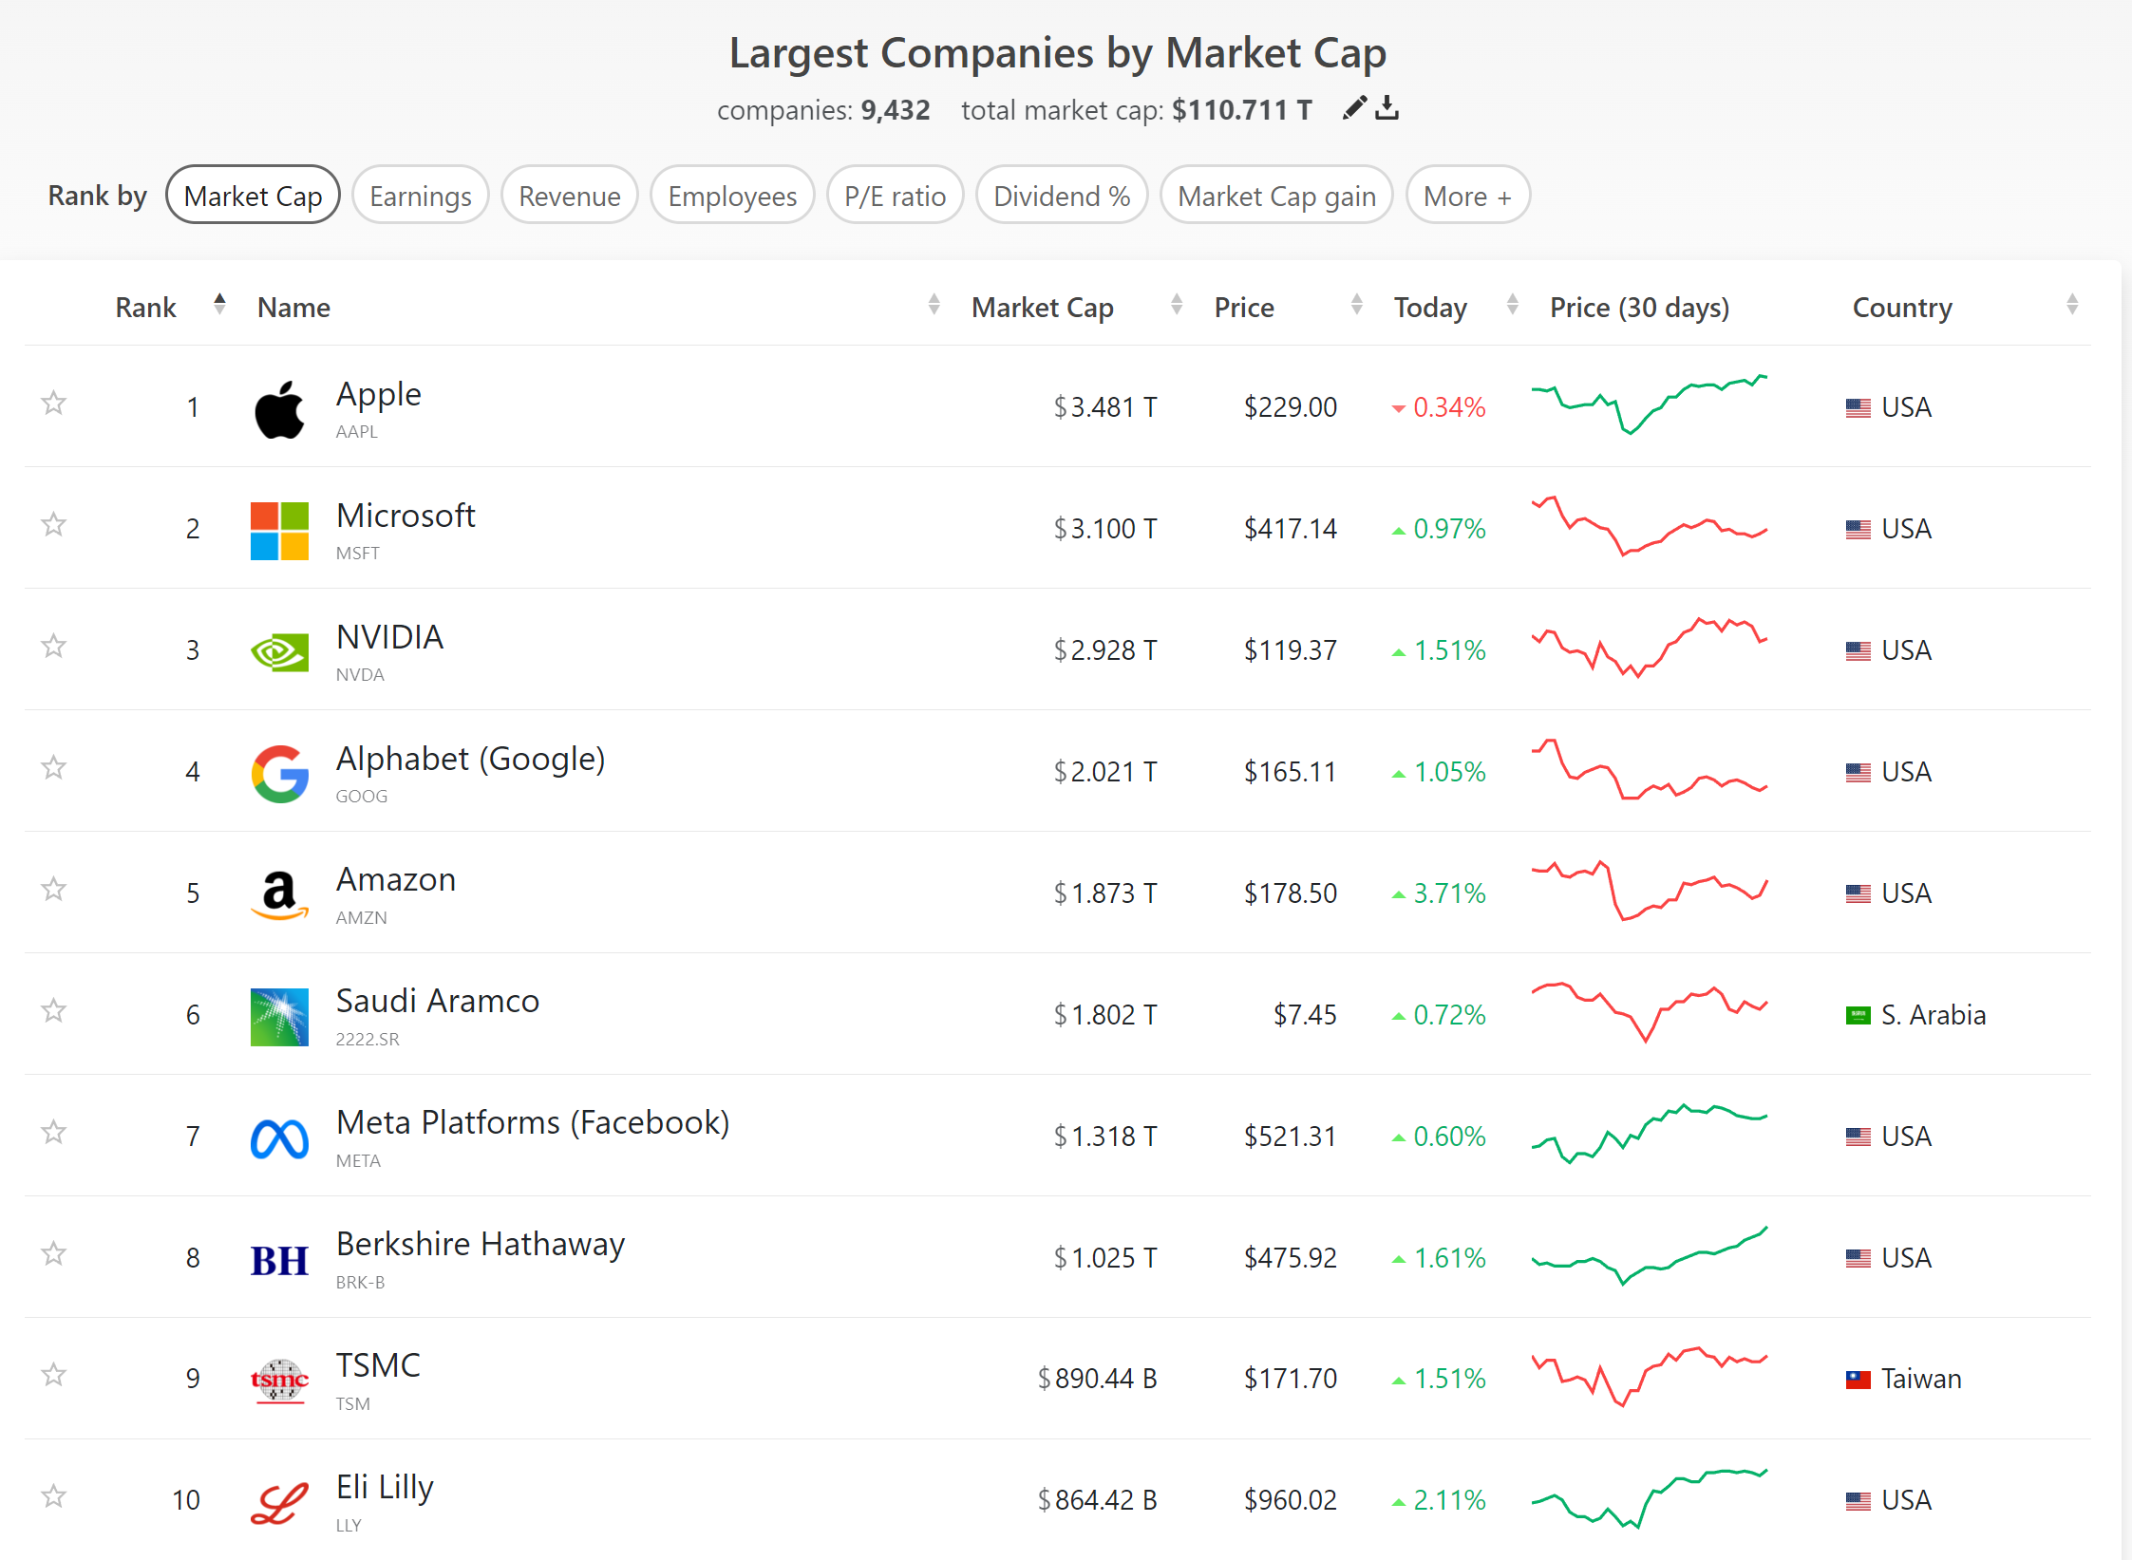
Title: Presentation
Subtitle field
What does market cap mean? How are they computed?

Slide 5
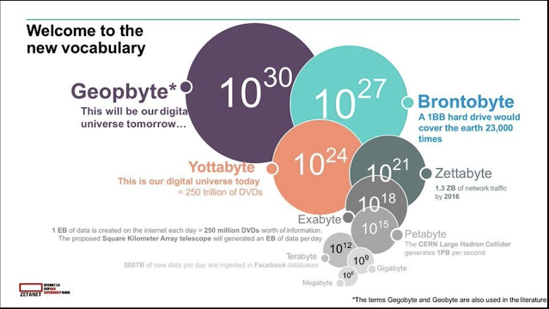
Has the digital economy reached a ceiling?
Title: Presentation
Subtitle field

Slide 6
Some new concepts
Title: Presentation
Subtitle field
Uberization, on-demand
Two-sided markets and economics of platforms
Collaboration : Wikipedia, crowdfunding, crowdsourcing
Long tail and attention economics
Makers/Influencers
Ad-blockers
Blockchain, crypto-currencies, Initial Coin Offering
AI, cloud

Slide 7
IS the digital economy a new economy?
Title: Presentation
Subtitle field
Do old economic laws still apply?

Slide 8
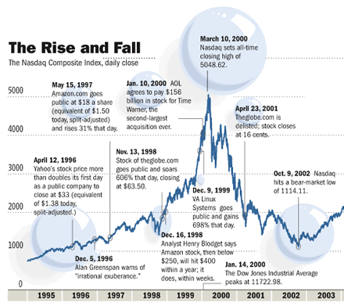
The dot com bubble
Economics of digital markets
Subtitle field

Slide 9
KEY concepts
Title: Presentation
Subtitle field
Information externalities
Network externalities and two-sided platforms
New business models
Costly to produce, costless to reproduce
Public good
Digital commons
Experience good
Complementarity between data and algorithms

Slide 10
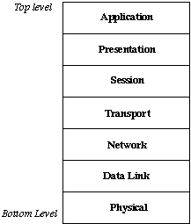
Internet infrastructure
Title: Presentation
Subtitle field
Open Systems Interconnection
Each layer is independent
Well defined input and output
Examples of Internet protocols: telnet, ftp, smtp/pop3/imap, http, tcp/ip

Slide 11
A SIMPLIFIED 3-layer model
Title: Presentation
Subtitle field
Content; IP rights enforcement
Logical = "machinery" of the internet, software, OS;
Physical = computers, wireless devices, modemcables, switches, ..

Slide 12
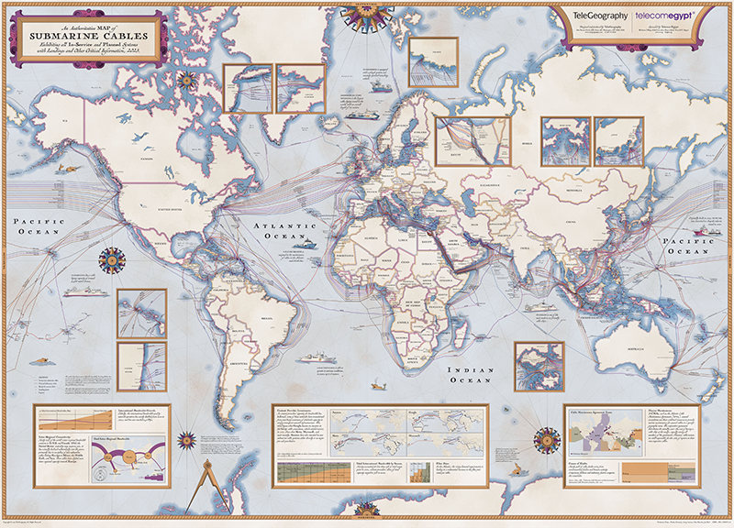
Title: Presentation
Subtitle field

Slide 13
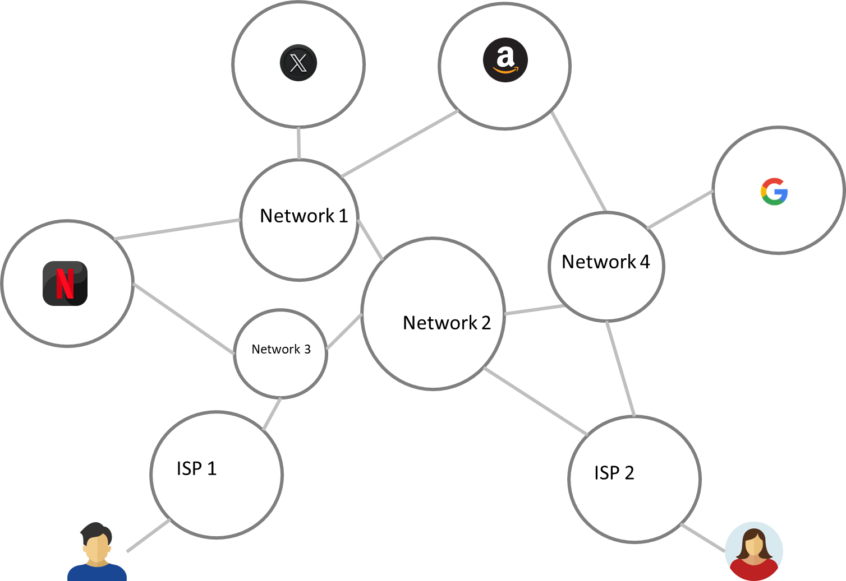
Title: Presentation
Subtitle field

Slide 14
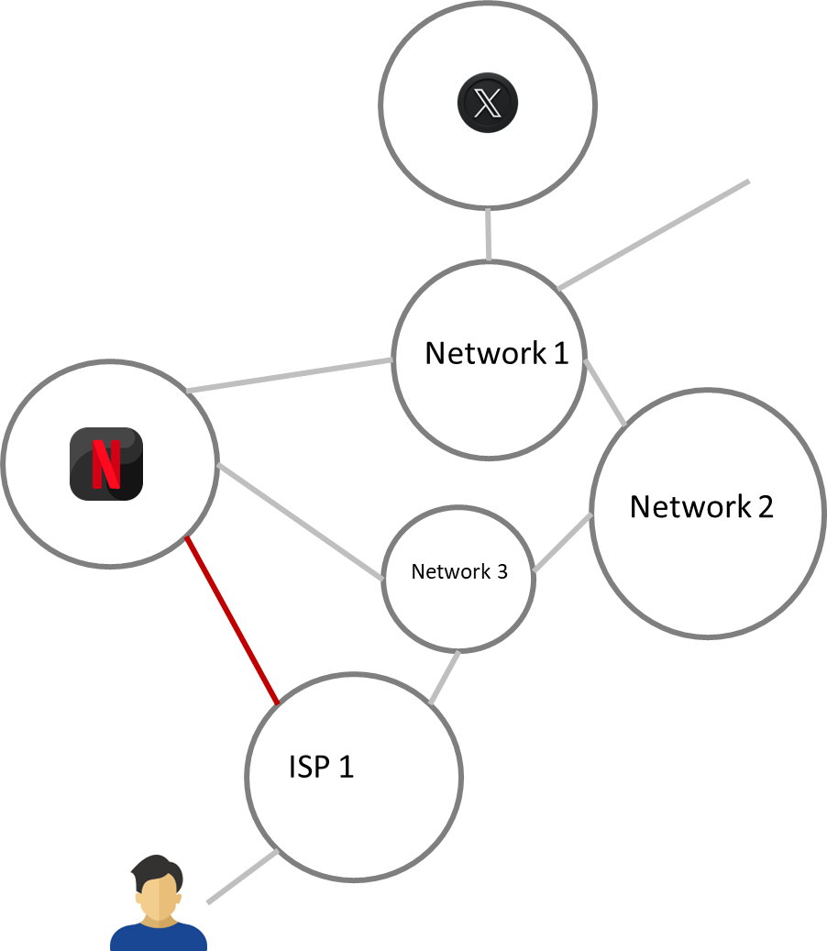
HOW do you manage such a gigantic network?
Title: Presentation
Subtitle field
Best effort: technical operators manage their network the best way without discriminating traffic
Direct connection through Peering agreements
Routing traffic
Resilience through redundancy

Slide 15
Net neutrality
Title: Presentation
Subtitle field
“Net Neutrality is what makes the Internet so great - and so vital for innovation and creativity.” - Justine Bateman
End-to-end principle = "dumb" network vs. packet discrimination; net neutrality
Avoids a tiered Internet
ISPs are gatekeepers

Slide 16
The debates
Title: Presentation
Subtitle field
“Net neutrality was essential for our economy; it was essential to preserve freedom and openness, both for economic reasons and free speech reasons.” - Julius Genachowski
3 debates:
Technnical: can you efficiently discriminate packets?
Economical: bargaining power between Internet Service Providers (ISP) and Content and Application Providers (CAP); network upgrades, innovation and content creation
Societal and political: privacy, freedom of speech, freedom to be informed, democracy

Slide 17
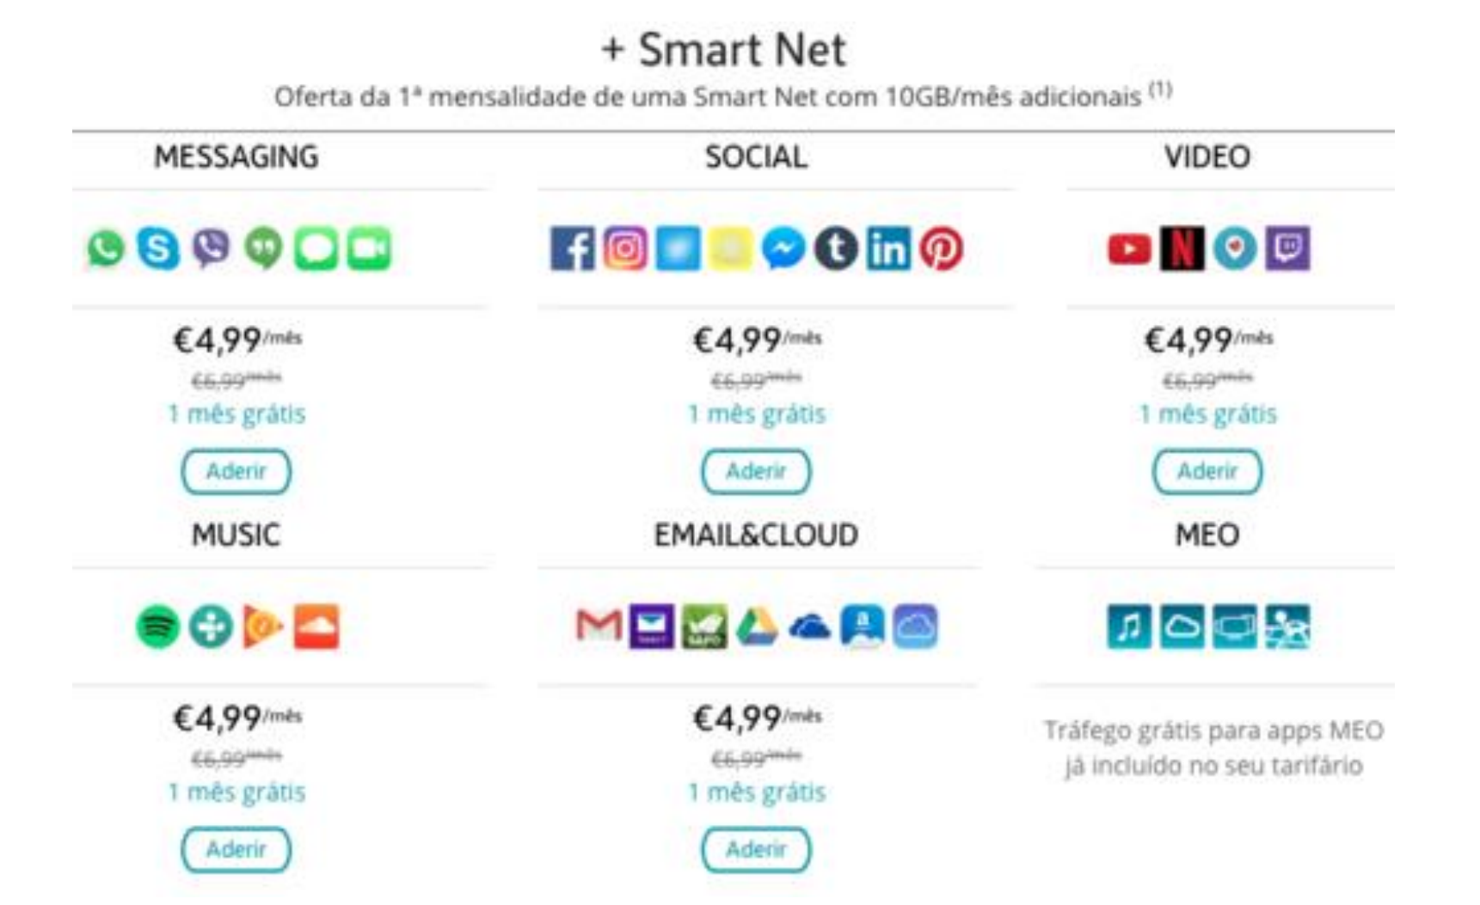
ZERo rating
Title: Presentation
Subtitle field
Bundling and price discrimination
Grey area of regulation
Right panel: Meo offer in Portugal

Slide 18
Open internet regulation
Title: Presentation
Subtitle field
Apply the same principle to other layers of the Internet
OS
Stores
Search
Problem: the core of their business models is to filter
In France: Loyauté < République numérique
Use case: Google shopping (2.4 Billion EUR)

Slide 19
Title
Subtitle

